Slide 1
Bee, I’m Expecting You
Both Parts
Unison Dominant
Accompaniment Only

Slide 2
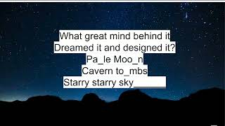
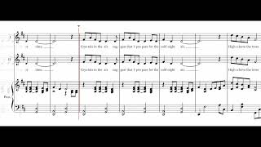
Circle ‘Round the Moon
Part 1
Part 1
Practice Tracks for "Circle 'Round the Moon"
0:00 - all parts balanced
2:17 - Part 1 emphasized
4:35 - Part 2 emphasized
6:54 - the instrumental parts emphasized
Part 2
Accompaniment
Both Parts

Slide 3
Shine Like Stars
Part 1
Part 2

Slide 4
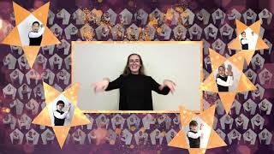
I'm dreaming wide awake.
This is the life I make.
Don't need a holiday
to make me feel this way.
Listen up. Take a chance.
You can sing. You can dance.
You can live like there's no tomorrow.
Give it time and you'll find.
There's a rule. There's a rhyme.
Move along and the rest will follow.
I want you to know…
What are we waiting for?
It seems we still want more.
No one can take away
The dreams we have today.
You can go with the flow
Don't you see don't you know
There's a light let it burn inside you.
You can shout let it out
Not a care, not a doubt
This is it. Let the moment guide you.
I want you to know…
FULL
ACC
Oh yeah, we shine like stars! Oh yeah, we shine like stars!
Like stars! Like stars!
We shine! We shine like stars! We shine! We shine! (2X)
Like stars! (3X)

Slide 5
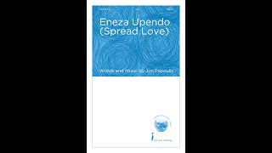
Eneza Upendo
(Spread Love)
Pronunciation
Part 1
Part 2

Slide 6
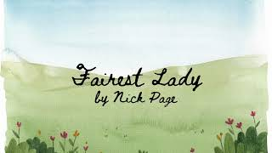
Fairest Lady
0:00 Both Voices and Piano
3:19 Part 1 Alone
6:17 Part 2 Alone
9:18 Piano Alone
Part 1 - with descant
Part 2 - with melody on page 4

Slide 7
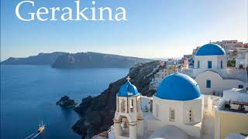
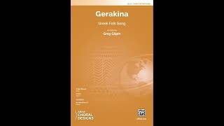
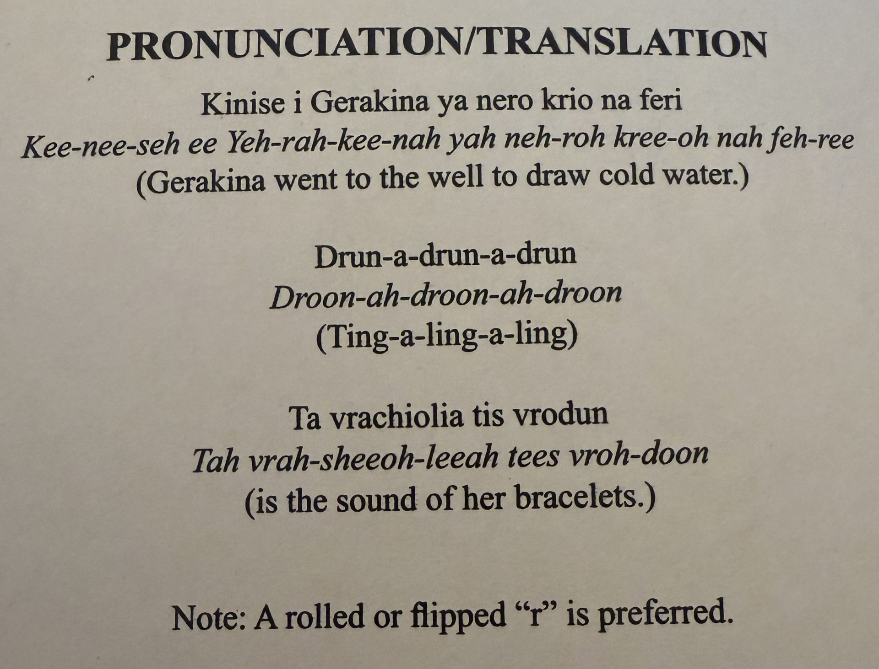
Gerakina
Greek Folk Song
Pronunciation Part 1
Part 1
Pronunciation Part 2
Part 2
Descant
ACC ONLY

Slide 8
Oh, say can you see by the dawn’s early light,
What so proudly we hailed at the twilight’s last gleaming?
Whose broad stripes and bright stars,
Through the perilous fight,
O’er the ramparts we watched, were so gallantly streaming?
And the rockets’ red glare, the bombs bursting in air,
Gave proof through the night that our flag was still there.
Oh, say, does that Star-Spangled Banner yet wave
O’er the land of the free and the home of the brave?
FULL
ACC

